Slide 1
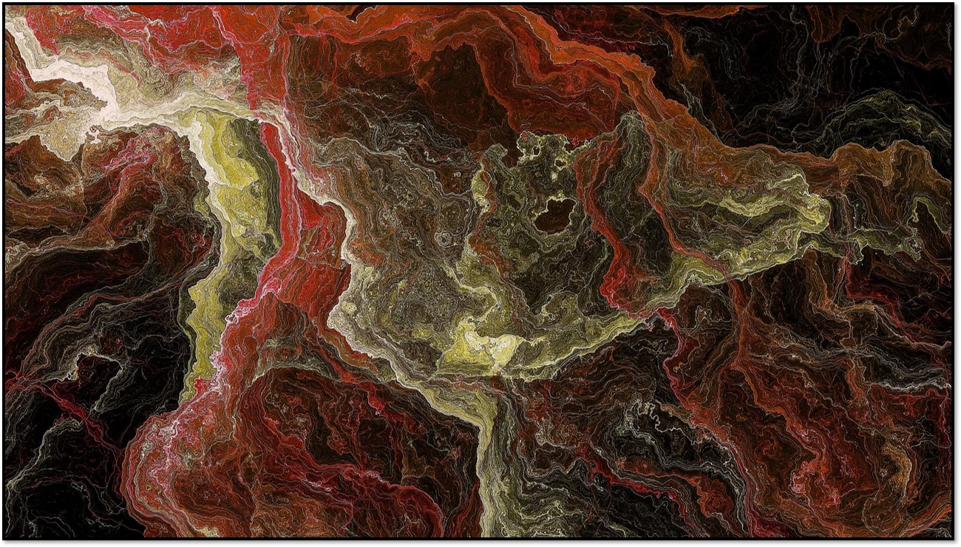
Computer Networks 18CSC302J
NETWORK DESIGN PROPOSAL FOR INTERNET CAFÉ
Created by :-
Anurag Nimonkar(RA1811027010012)
Nivetha Jayakumar(RA1811027010013)
Sahil Rao (RA1811027010023)
Tamojit Sarkar (RA1811027010034)

Slide 2


Abstract
This project presents a design and prototype implementation of a cybercafé to support 30 users who all share the same ADSL network, where the access to certain sites(servers) are blocked with the help of a firewall. The café has a printing facility too.
A wireless network (ADSL connection) has to be designed that gives users access to certain sites.
There are 31 Client computers and a printer to print the files. Three servers are used in the ADSL side to show the working of these computers. The DNS server, the server for Google and YouTube. The IP for YouTube is blocked with the help of a firewall.
All 30 PCs are configured to share the same network. A billing software like True café will be installed in all PCs.
A common cloud storage will also be used for users to download and print files. This common shared storage avoids cluttering of the PCs’ local storage with unnecessary data and the need to manually clean them out after every use.

Slide 3
Introduction
An internet café, also known as a cyber café, is a café, convenience store or a fully dedicated internet-access business that provides internet access to the public.
An asymmetric digital subscriber line (ADSL) is a type of digital subscriber line (DSL) technology (a data communication technology) that enables faster data transmission over copper telephone lines than a conventional voiceband modem can provide. Bandwidth and bit rate are said to be asymmetric, i.e., greater toward the customer premises (downstream) than the reverse (upstream).
ADSL is usually used to access the internet to download content, but not for serving content accessed by others.
The fee for using a computer in an internet café is generally charged as a time-based rate.

Slide 4
Literature review
The original ADSL architecture uses quadrature amplitude modulation (QAM) to transmit data on the down stream channel. This uses a single carrier frequency to modulate the signal.
QAM allows telephony and the reverse channel to be frequency division multiplexed on the same pair of wires. This setup has no self-near-end cross talk or reverse cross talk which is what gives us the ability to transmit data over long distances. However it does have self-far-end crosstalk which needs to be modelled as a source of performance limitation along with background noise.
Trying to transmit data at a high rate in both (upstream and downstream) directions over a single pair of wires can lead to neither side being able to send or receive data. ADSL overcomes this by transmitting data at a high rate downstream and a lower rate upstream by frequency division multiplexing

Slide 5
Literature review
Firewalls are a fundamental part of network security and often function as the first line of defence, partially separating a local network from the Internet. The task of the firewall is to prevent unauthorized network traffic from passing through itself into the protected network.
To make a firewall function properly it has to be told what traffic is to be authorized and what is not. This is done in a configuration file typically called a ruleset. The rule set is an ordered list of rules, where each rule is of the form predicate ! action. The predicate typically contains a range of source IPs, a range of destination IPs, source port, destination port, protocol and the action typically is either accept, discard, log or a combination of these.
When packets arrive at the firewall they are matched against this list of rules. Overlapping and conflicting rules are normal occurrences. To resolve the conflicts, the action of the first rule that matches the packet will been forced, therefore the order is crucial and changing the order could change the behavior of the firewall drastically.

Slide 6

Architecture
The computers corresponding to the users connect to the ports on the switches. As Shown in the fig. above.
The switches are 24 port switches each. The computer connects to the switch using Ethernet RJ 45 cables.
The café management software is installed on the appropriate operating system and set up on the network.
The firewall along with the ADSL router-modem is deployed as shown in the diagram. This has two interfaces. WAN interface of the router is connected to the internet and the LAN interface is switch.
The ADSL router is configured for NAT. When the feature is enabled, internal users would be able to share the IP Address which would be available on the WAN interface of the router.
The DHCP feature on the firewall is configured for NAT. When the right command is called, it would provide appropriate IP Address, subnet mask, default gateway and DNS server IP Addresses for the user’s computers.

Slide 7
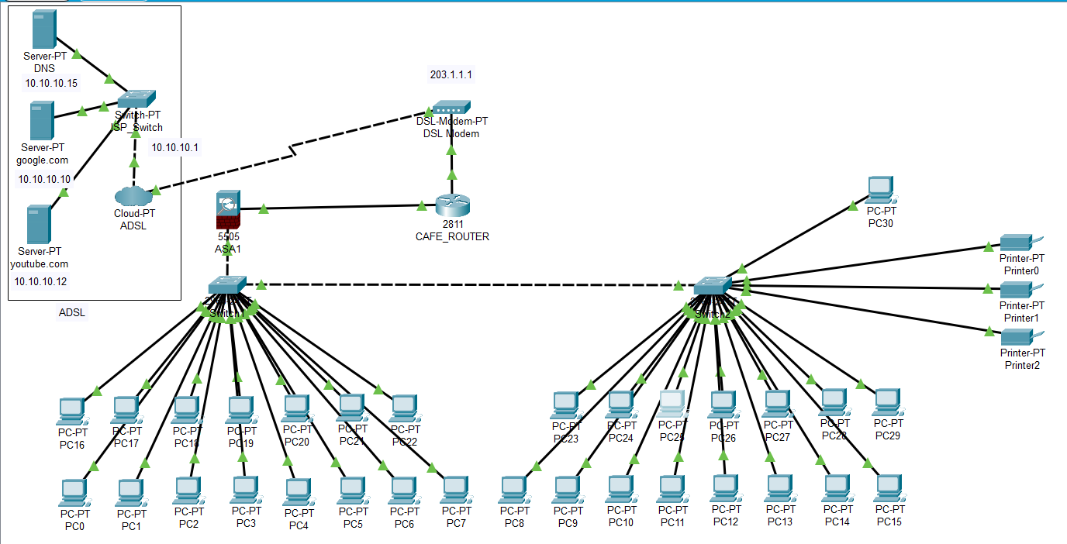
Network Diagram

Slide 8
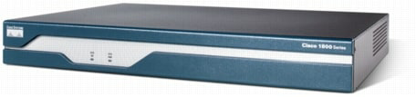
Design with Modules Description
1. Router 2811(NM-ESW-161 port) and Router 1841
The Cisco 1841 router is designed for secure data connectivity and provides significant additional value compared to prior generations of Cisco 1700 Series routers by offering more than a fivefold performance increase and integrated hardware-based encryption enabled by an optional Cisco IOS ® Software security image. The Cisco 1841 dramatically increase interface card slot performance and density over the Cisco 1700 Series while maintaining support for more than 30 existing WAN interface cards (WICs) and multiflex trunk cards

Slide 9
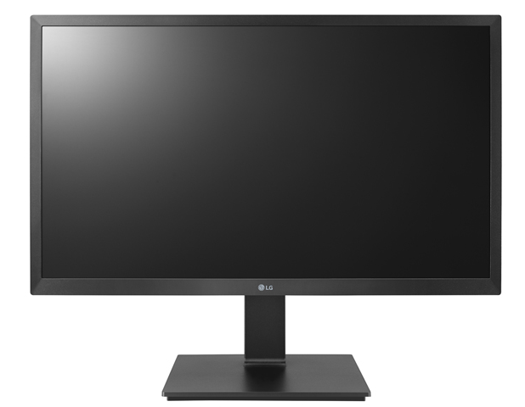
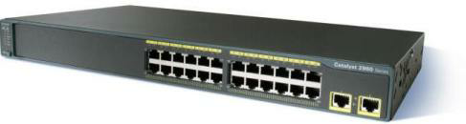
2. PC-PT Computers
A device that performs processes, calculations and operations based on instructions provided by a software or hardware program. It has the ability to accept data (input), process it, and then produce outputs.
3. 2960-24TT Switches
Cisco Catalyst 2960 Series Switches with LAN Lite software are fixed-configuration, standalone switches that provide desktop Fast Ethernet connectivity for entry-level wiring closet and small branch-office networks . These switches simplify the migration from non-intelligent hubs and unmanaged switches to a fully scalable managed network. Cisco Catalyst 2960 Series Switches have lower cost of ownership with features such as intelligent switch configuration using Auto Smart Ports, installation with Auto Install and enhanced troubleshooting to facilitate ease of use.

Slide 10
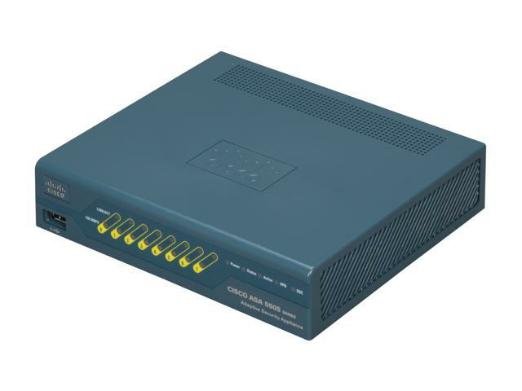
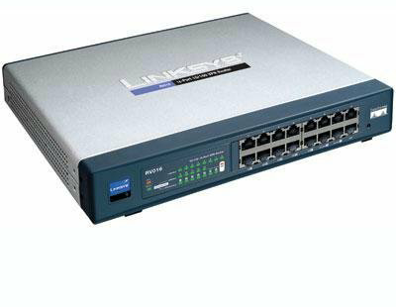
4. Cisco ASA 5505
Cisco ASA 5500 Series Adaptive Security Appliances are purpose-built solutions that integrate world-class firewall, unified communications security, VPN, intrusion prevention (IPS), and content security services in a unified platform. The Cisco ASA 5500 Series provides intelligent threat defense that stops attacks before they penetrate the network perimeter, controls network and application activity, and delivers secure remote access and site-to-site connectivity. The result is a powerful multifunction network that provides security breadth, precision, and depth for protecting the café network, while reducing the overall deployment and operations costs associated with implementing comprehensive multilayer security.
5. DSL-Modem-PT
A digital subscriber line (DSL) modem is a device used to connect a computer or router to a telephone line which provides the digital subscriber line service for connection to the Internet, which is often called DSL broadband. The term DSL modem is technically used to describe a modem which connects to a single computer, through an Ethernet port, USB port, or is installed in a computer PCI slot. The more common DSL router is a standalone device that combines the function of a DSL modem and a router, and can connect multiple computers through multiple

Slide 11
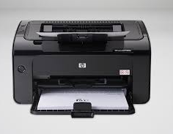
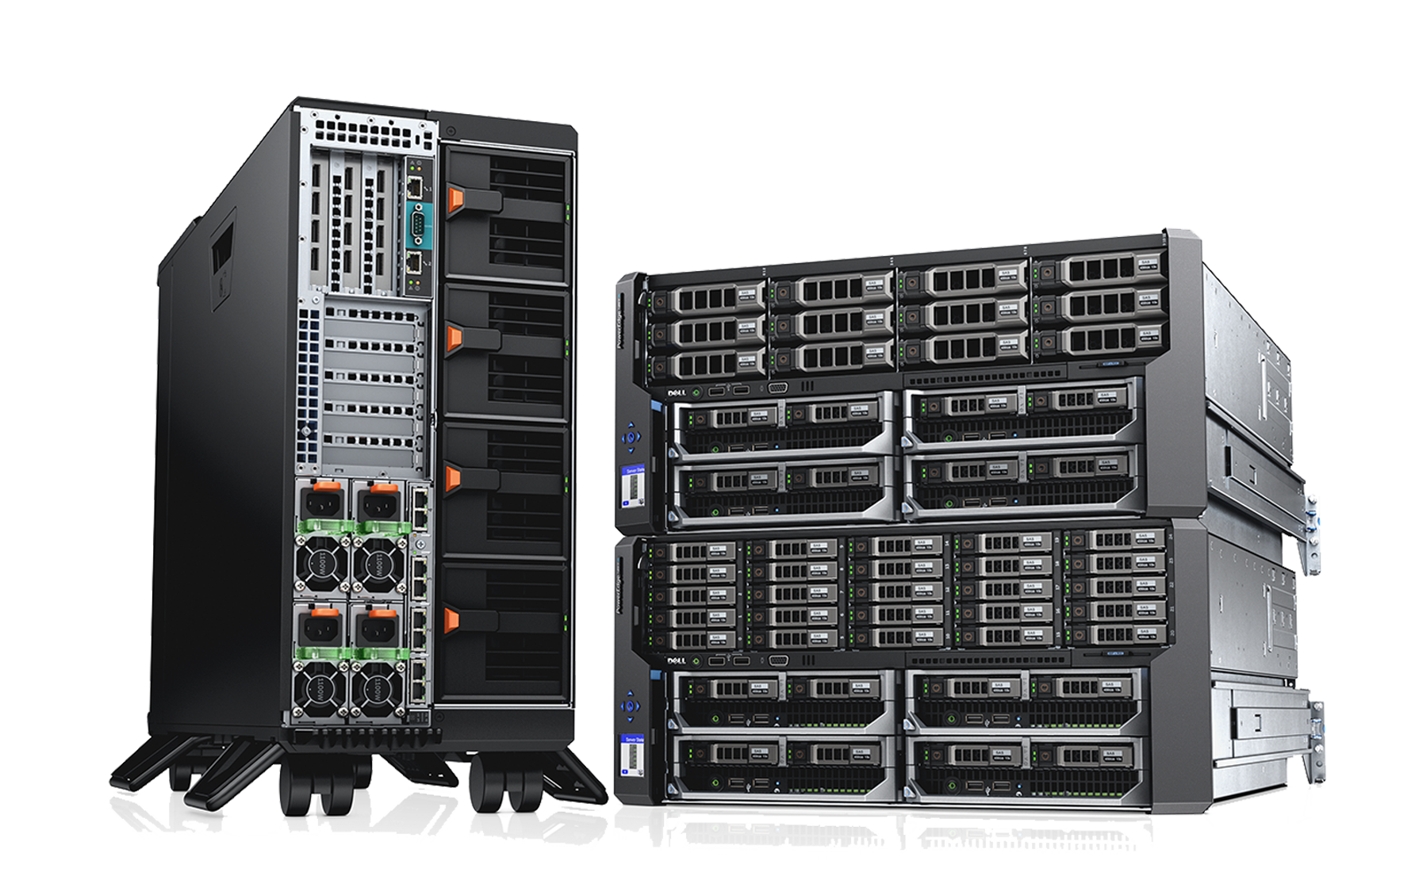
6. Printer PT
A Printer is a peripheral device which makes a persistent representation of graphics or text, usually on paper. While most output is human-readable, bar code printers are an example of an expanded use for printers.
7. Server-PT servers
Servers are an entirely different breed when compared to other end devices. They have various functionalities and also have space for two network interfaces. The modules available for servers are the same as PC modules, except that the servers do not have the PC-HOST-NM-1AM module.

Slide 12
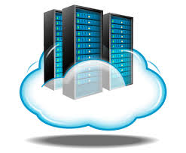

8. Cloud-PT(Multiuser)
Cloud allows us to implement cloud computing in our project. Cloud computing is the delivery of on-demand computing services -- from applications to storage and processing power -- typically over the internet and on a pay-as-you-go basis.
9. TrueCafe
Its an internet café software, which helps in the management of the café by providing features like wireless billing(Wi-Fi hotspot supported),print management, power management, web reports etc. This software plays a key role in managing the café efficiently.

Slide 13
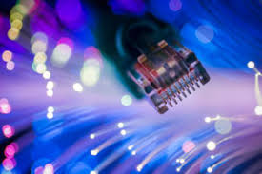
Implementation
The internal private IP Address range for the users and other devices within the café is 192.168.1.2-36.
The subnet masks of all the devices are the same – 255.255.255.0
The IP Addresses of the LAN interface of the firewall and computer on which the café management system is setup should be configured with static IP Addresses (192.168.10.1) belonging to the 192.168.1.0/31.
It should be ensured that the static IP Addresses provided for the LAN interface of the firewall and the café management system is excluded from the DHCP scope configured on the router for avoiding duplicate IP addressing.
The default gateway and the DNS server which is to be provided in the DHCP scope would be the IP address of the LAN interface of the firewall.

Slide 14
Implementation
The default gateway for the three servers, i.e., the DNS server, Google server and YouTube server, is the same – 10.10.10.1
The switch is connected to Ethernet 6 of the cloud via port Fast Ethernet 3/1 with the help of a Copper Cross-Over.
The cloud is connected to modem 4 with the help of a Phone cable. The name of the modem and the port used for connection are added under DSL service of the cloud.
The IP of the interface between the ADSL connection and the café modem is the default gateway used for the servers, i.e., 10.10.10.1

Slide 15
Implementation
The IP of the interface between the modem and the router of the café is the default gateway used earlier, i.e., 10.10.10.1. The port used is Fast Ethernet 0/0 of the router.
The IP of the interface between the router and the firewall device is the default gateway of the router, i.e., 203.1.1.1. The port used is Fast Ethernet 0/1 of the router and Ethernet 0/0 of the firewall.
The firewall is connected to the first switch via port FastEthernet 0/17.
The default gateways of all the 31 PCs and the printers is the IP used at the interface for the firewall, i.e, 192.168.10.1.
All the PCs are connected to the switches via their port Fa0.
The first switch is connected to the second via ports Fa0/1 and Fa0/18 of the first and second switch respectively.

Slide 16
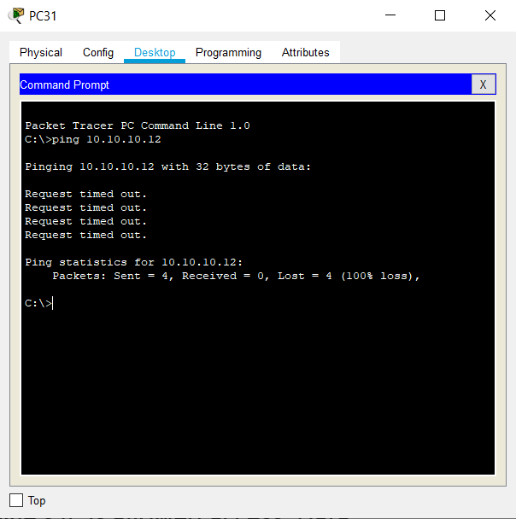
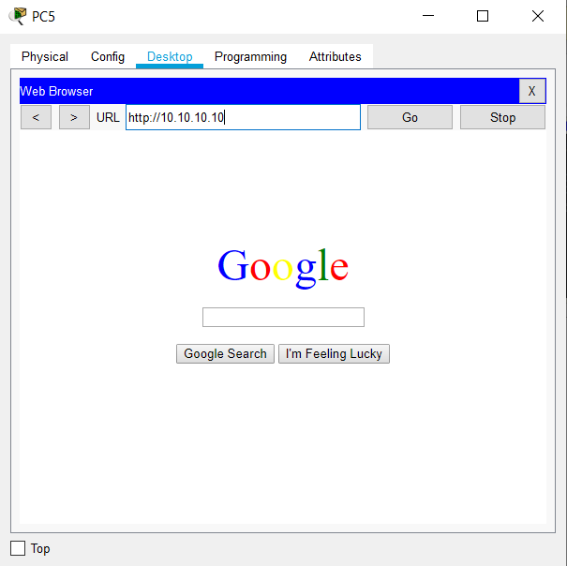
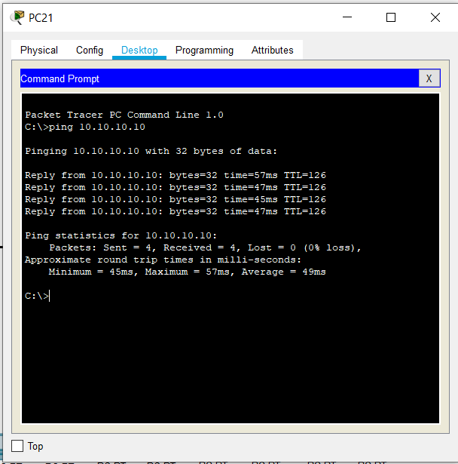
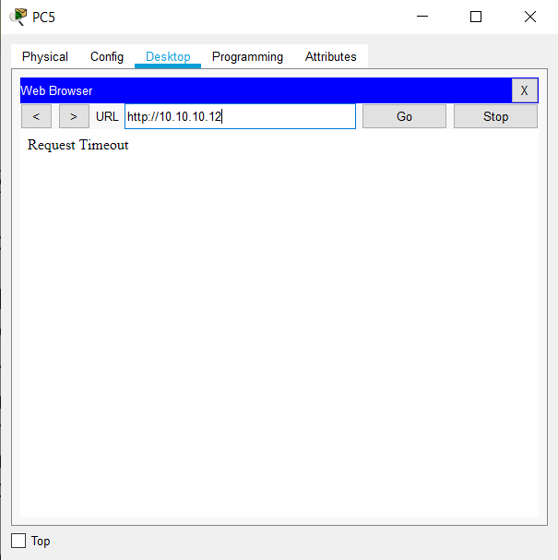
Results and Discussion
All computers have been connected to the internet via ethernet cables. Data packets are sent and received from the servers successfully
A firewall was used to block Youtube’s IP from being accessed by the computers in the internet café. Data packets are not transmitted from the server. The request reaches a time-out as it doesn’t receive any response from the server.
Google’s IP is allowed access. Data packets are sent and received from its server.

Slide 17
Conclusion
A network design for an internet cafe supporting 30 users has been created successfully. All users share a common ADSL network. Certain websites have been blocked using an extended ACL in the firewall. A billing software has been installed on all the PCs to monitor usage. The cafe also has printing, FAX and Xerox facilities. The PCs are coupled with a common storage for the users to download and print files.
All the possible issues have been considered and suitable measures have been taken to avoid them. The devices have been configured and a working model of the network has been created on a simulator (Cisco Packet Tracer) successfully.

Slide 18
References
https://www.google.co.in/
https://www.youtube.com
https://www.wikipedia.org
https://www.netacad.com/courses/packet-tracer/introduction-packet-tracer
http://kth.diva-portal.org/smash/get/diva2:1232063/FULLTEXT01.pdf
http://users.ece.utexas.edu/~bevans/courses/ee382c/projects/spring00/agarwal-desikan-sankar/LitSurveyReport.pdf

Slide 19
Thank You

